Slide 1
CO2201 Software Engineering Project

Slide 2

Project Software Architecture
1. Presentation Layer - React
2. Application Layer – Django
3. Data Layer – SQLite
4. Web Server Layer – Rest API

Slide 3
Application Layer – React
React is fast and efficient, particularly for building large and complex user interfaces
Virtual DOM

Slide 4
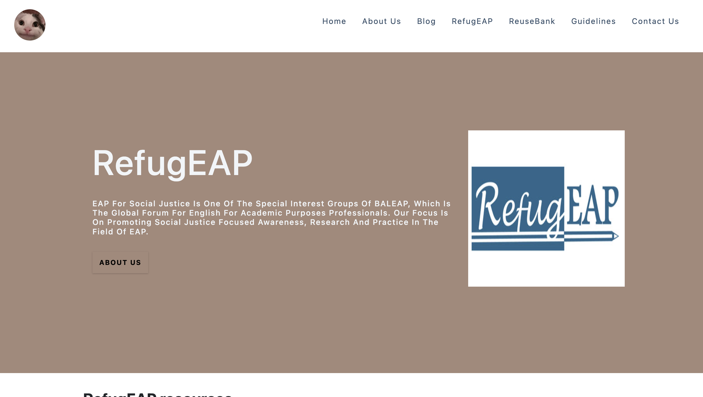
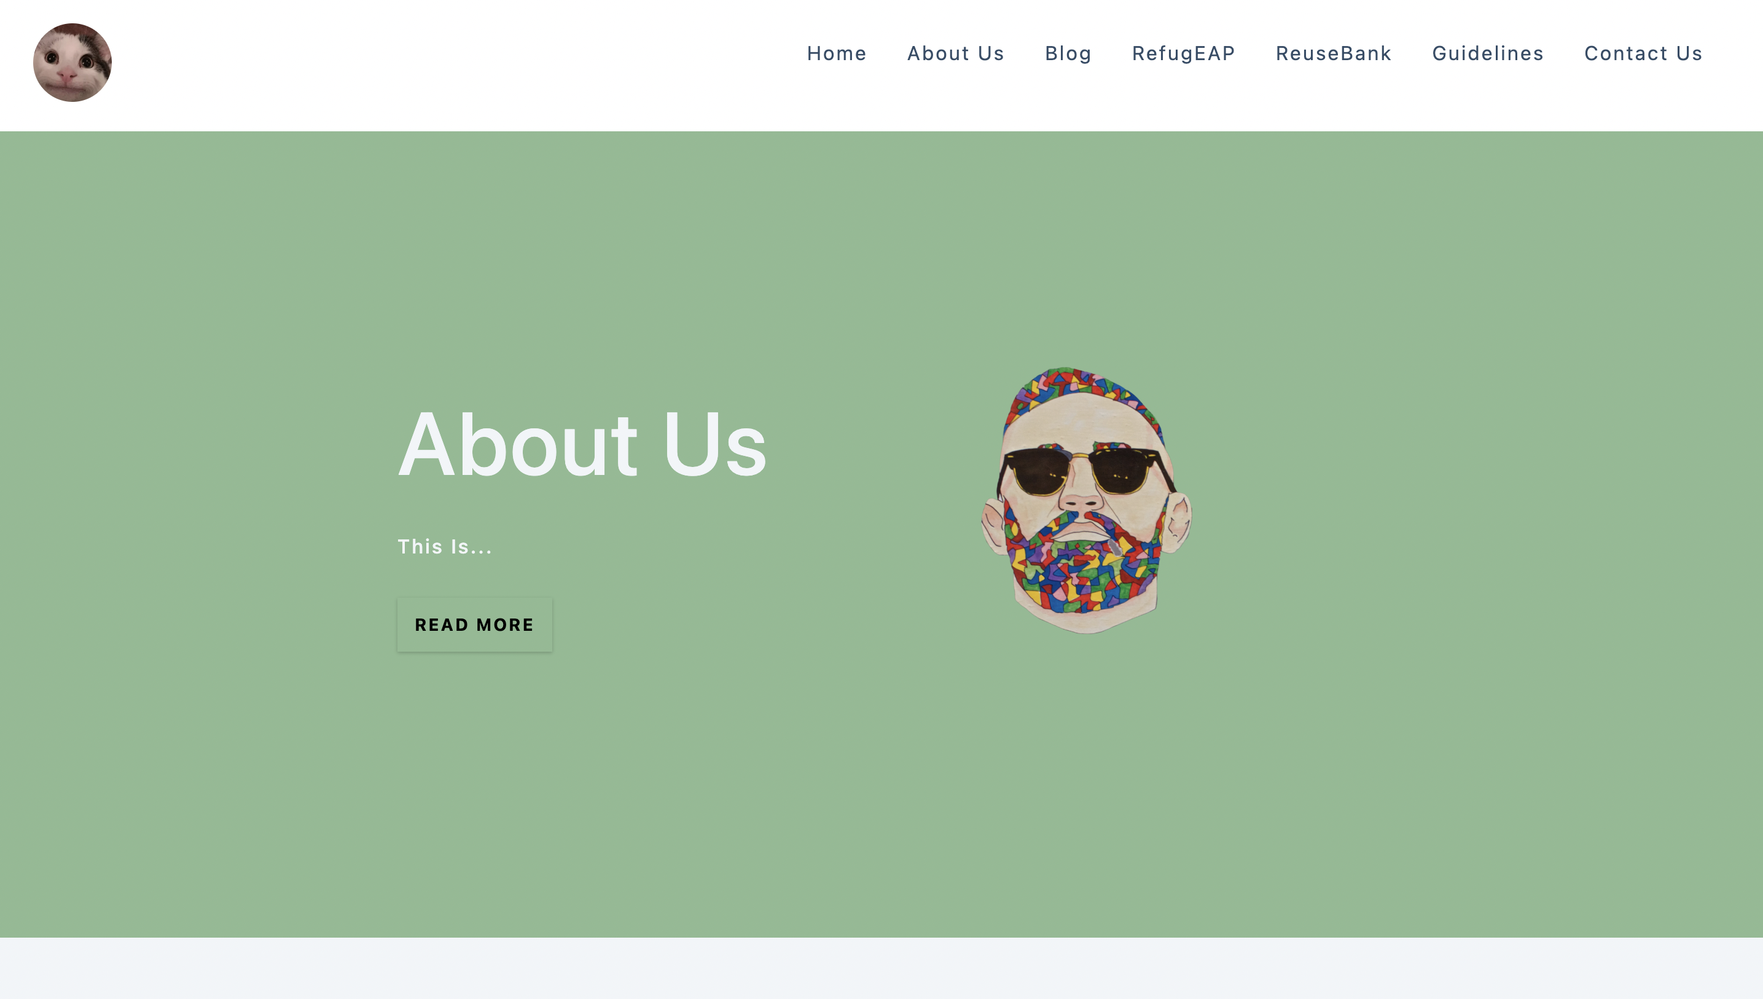
Component-based architecture
Reusable UI components
Reusable code
Consistency

Slide 5
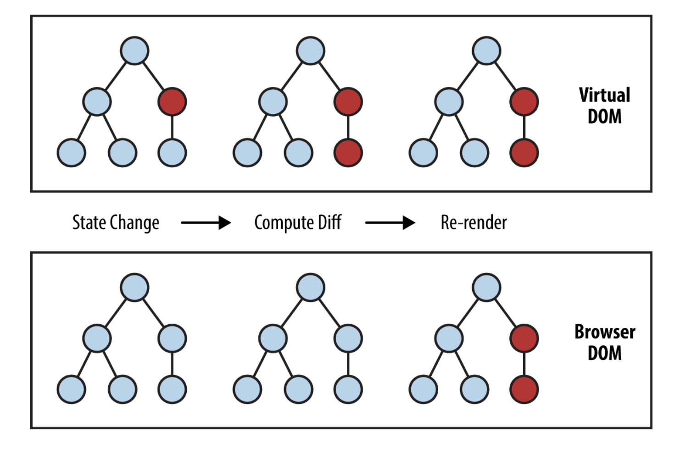
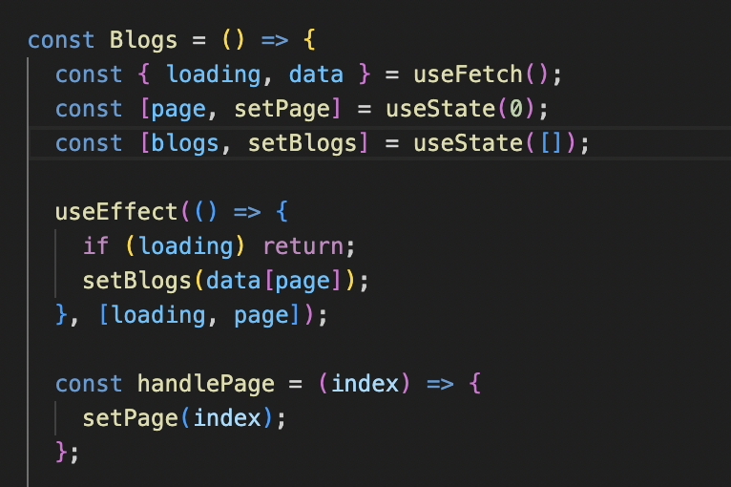
Virtual DOM (Document Object Model)
Lightweight representation of the actual DOM
Only parts of the actual DOM being updated
Improved performance and efficiency

Slide 6
Does the virtual DOM update every single time when a component’s state or a prop changes?

Slide 7
NO!
React processes state updates asynchronously -> trigger a separate render cycle -> multiple updates to the virtual DOM
To improve performance, React batches state updates together that occur within a single event loop cycle, and performs a single update to the virtual DOM at the end of the cycle – batching
Batching allows React to optimise the rendering process

Slide 8

Application layer – Django
A MVC framework
High Productivity - built-in components such as ORM (Object-Relational Mapping) tool and the template engine
A wide range of built-in features - built-in features including authentication, database management, and URL routing
Scalability - features such as caching and database sharding
Security - protection against SQL injection and cross-site scripting (XSS)

Slide 9
Data Layer – SQLite
A relational database management system
ACID (Atomicity, Consistency, Isolation, and Durability) transactions, triggers, views, and indexes

Slide 10
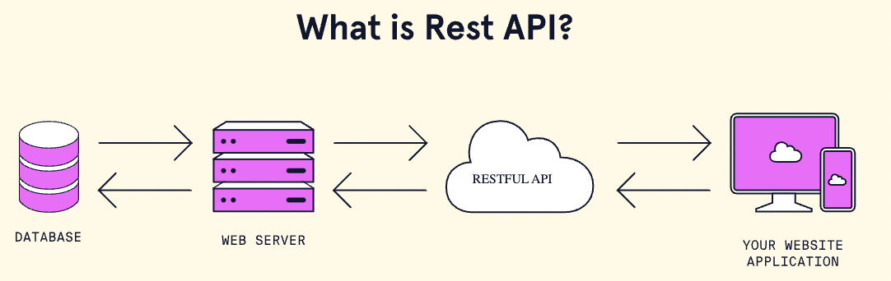
Web Server Layer – Rest API
Based on a client-server architecture that uses HTTP requests
Flexible and easy to integrate with other systems and services\
Easy to use

Slide 11
Other technologies for building API?
GraphQL
gRPC

Slide 12
Differences between REST, GraphQL, and gRPC
 | Rest | GraphQL | gRPC
Architecture | HTTP | HTTP/2 | HTTP/2
Data Fetching | HTTP requests | GraphQL data fetching | Binary Protocol
Performance | - | Better than Rest | Better than Rest

Slide 13
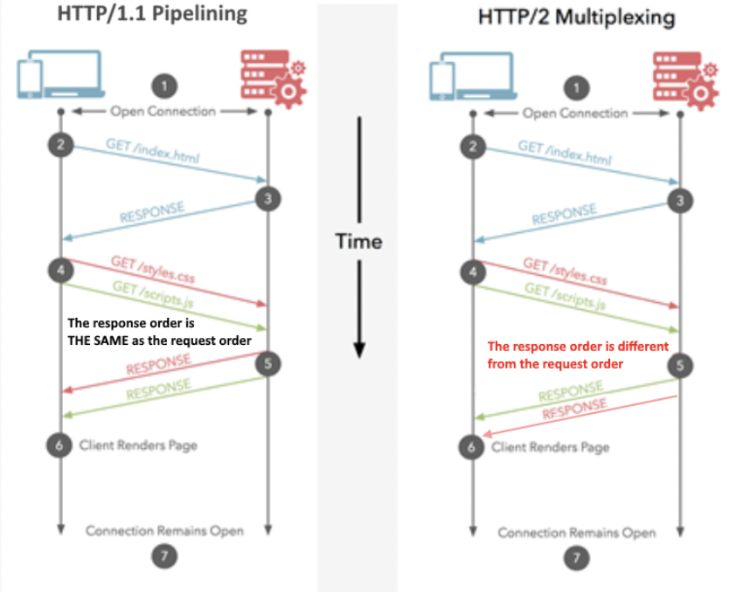
HTTP VS HTTP/2
HTTP2 – multiplexing multiple request at once on ONE TCP connection and receive requests in any order
HTTP/1.1 – pipelining receive requests in the same order they were requested

Slide 14

Realistic plans to take RefugEAP website onward.

Slide 15

Community Building
Encouraging user engagement by creating and maintaining a sense of community on the platform.
Implementing features such as discussion forums or user-generated content sections that enable users to share their experiences, knowledge, and support.

Slide 16
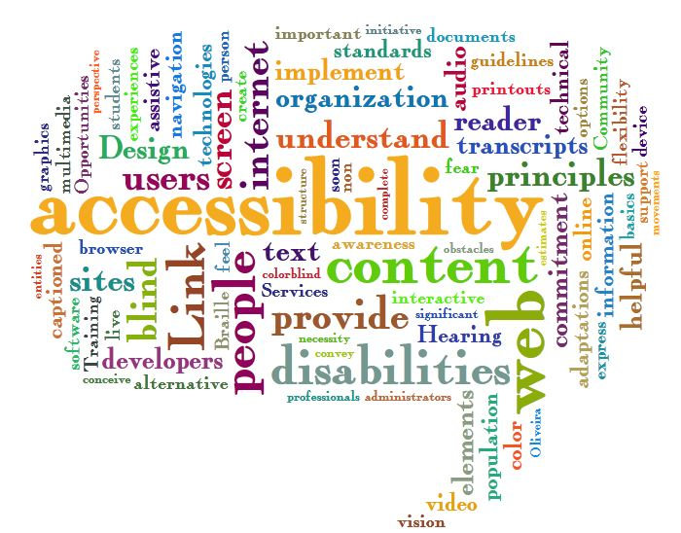
Accessibility and inclusivity
Ensuring that the website remains accessible and inclusive for all users, including those with disabilities.
Regularly check the website for compliance with accessibility guidelines and making necessary adjustments to maintain an inclusive experience for all users.

Slide 17

User feedback and Iterative Improvements
Collecting feedback from users to better understand what features of the interface they like, and to identify areas of improvement.
This will aid and prioritise new features and enhancements, ensuring that the website continues to meet the needs of refugees and stakeholders effectively.

Slide 18

Technical maintenance and security implementation.
Scheduling periodic maintenance to ensure the website remains secure, stable, and up-to-date with current technologies.
Implement regular security checks, updates, and backups to safeguard user data and minimize potential downtime.

Slide 19
A software design decision
Homepage links and theme

Slide 20

A snippet of the site before any design decisions were made
Lacking structure Harsh colour scheme Different fonts Unorganised
Notes:
Our problem was how we were going to present the homepage links in a neat an organised way without overcrowding the homepage as it already has a lot of information on it.
We decided to all individually come up with ideas for the site layout and theme and then hold a meeting where we combine our ideas and brainstorm together.

Slide 21

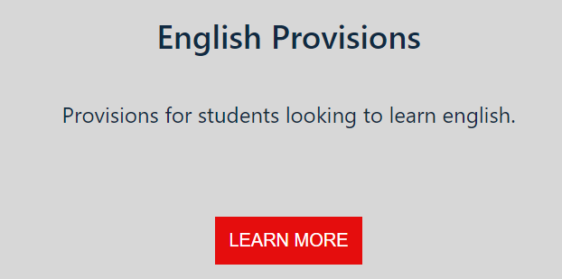
These were the homepage links we first created and were trying to transform. It was lacking and did not meet the requirements given to us by our client.
Notes:
During the last sprint after we had completed most of our user stories we realised that the site we had created was not organised and lacking structure due to the different features that were being added by a variety of people throughout the sprints. Here is an example of what it used to look like; quite tacky.

Slide 22
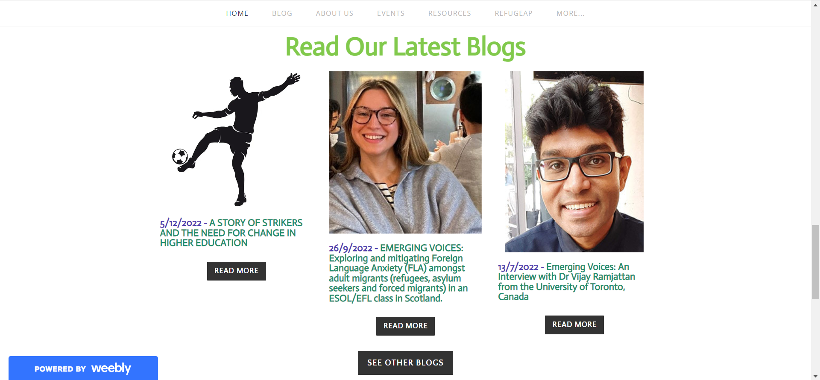
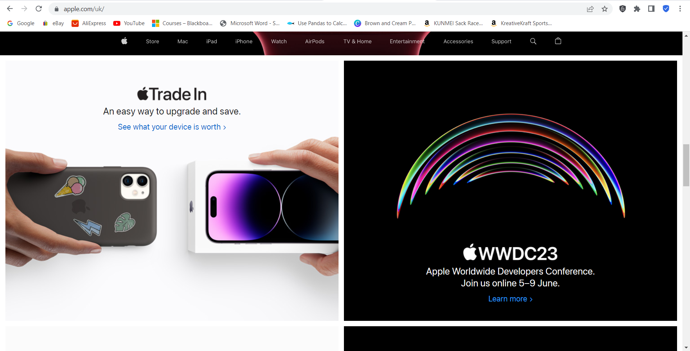
Inspiration from two sites; Apple and the official EAP website.
Notes:
We had taken inspiration from two sites, Apple and the official EAP website. We wanted to stick to what they already have as it aligned with what was requested so we didn’t want to stray too far. However, it seemed quite cluttered and we wanted a more neater aesthetic like the Apple site.

Slide 23
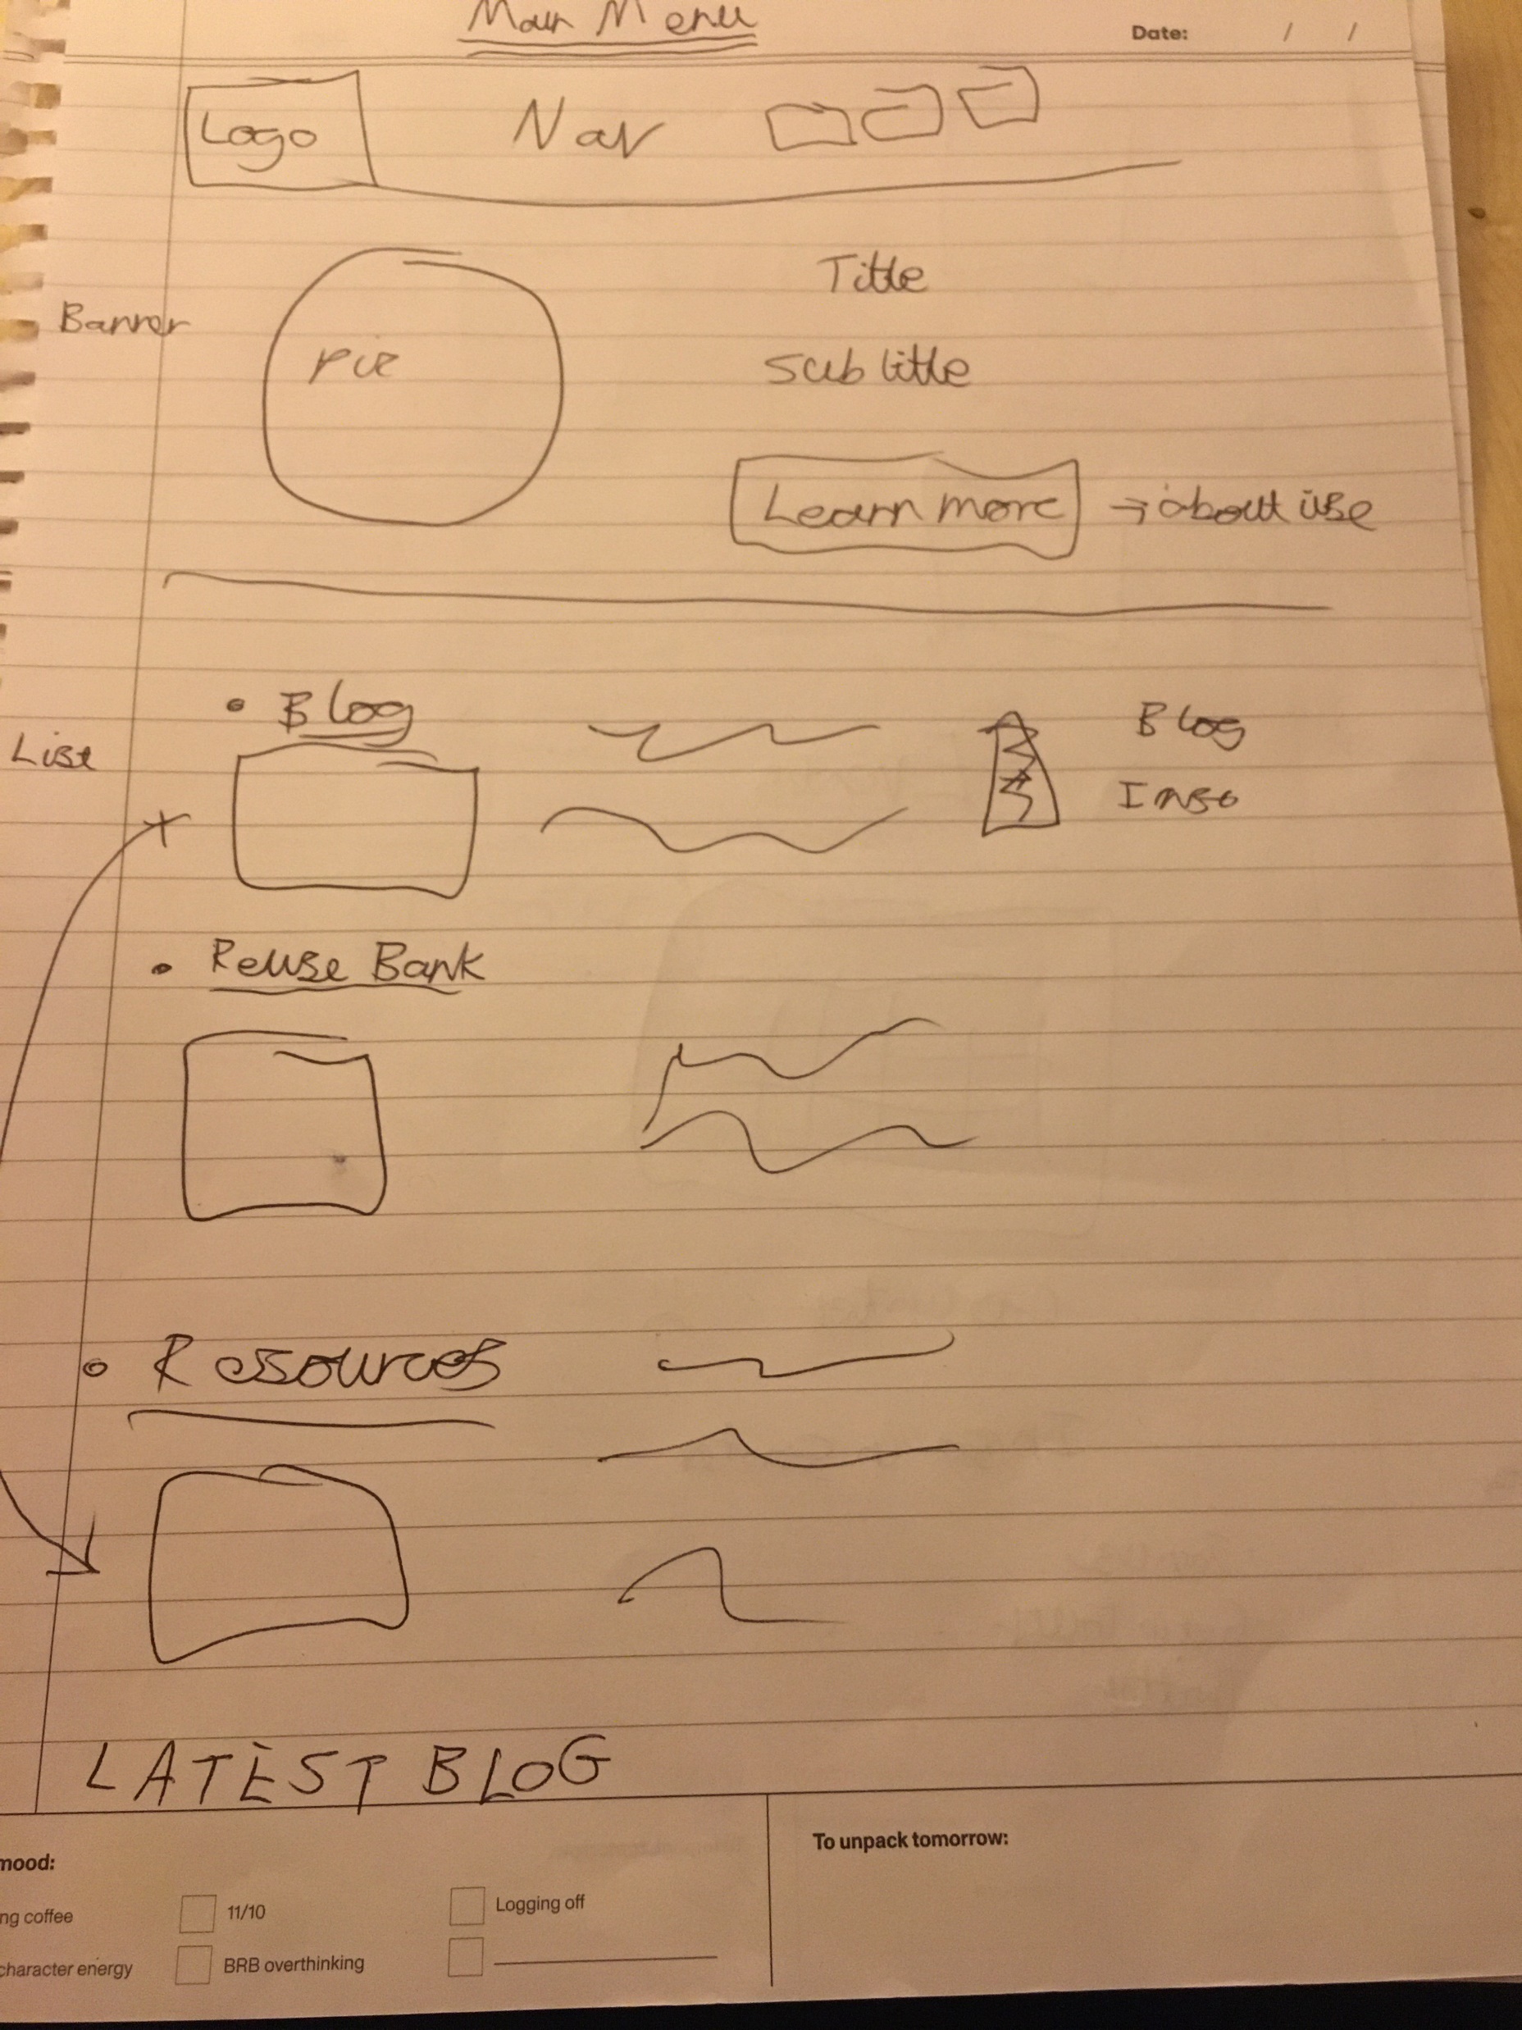
The final sketch.
Notes:
We sketched out rough designs at our held meeting of all the features we needed on the page and then we played around with the order and layout until we were all satisfied with the final result.
The final sketch has everything requested by the client and also meets our standards of what we wanted to produce.

Slide 24
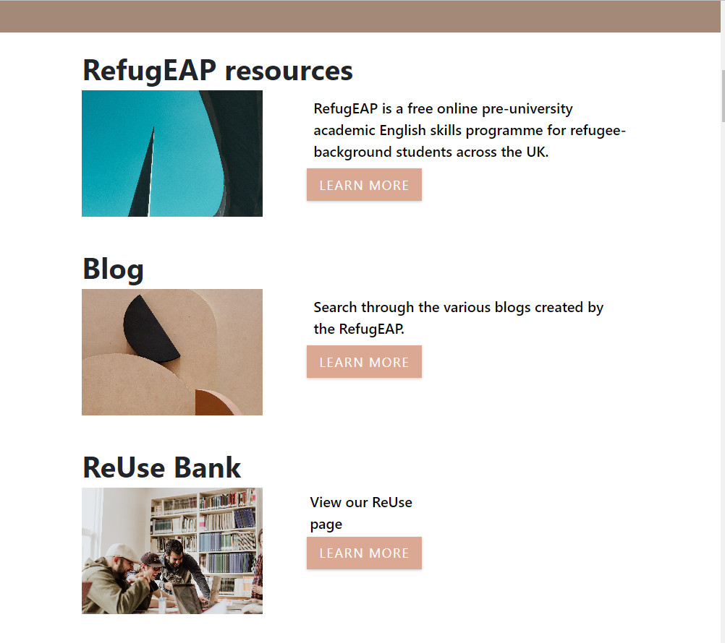
Our final homepage link design.
Notes:
This is the final design created after the sketch.

Slide 25
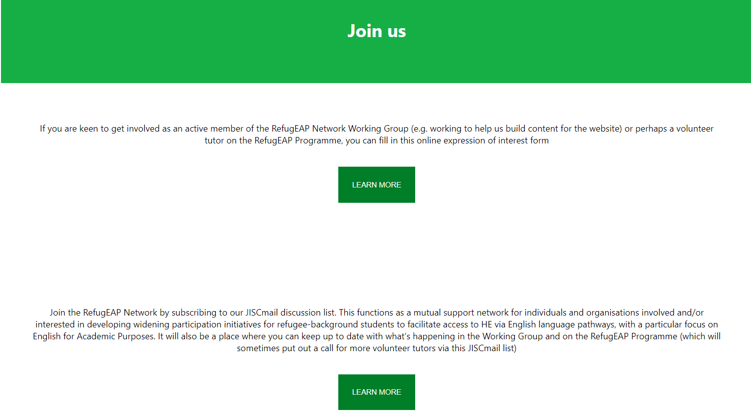
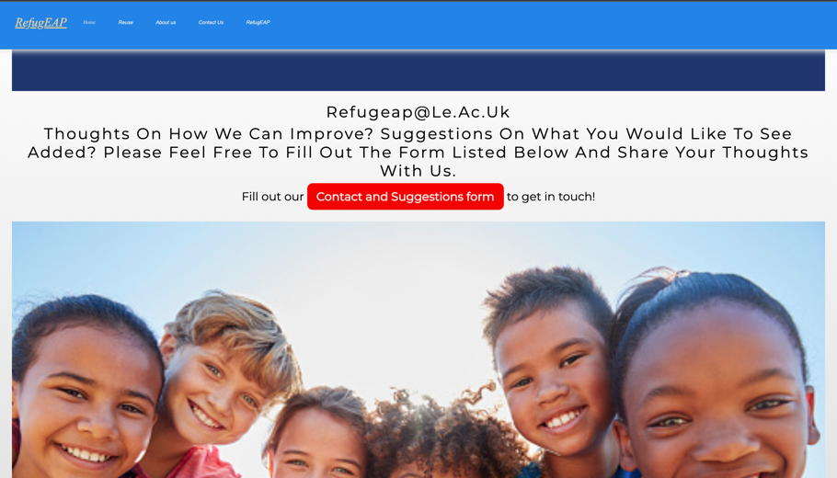
Colour scheme
Notes:
Another main issue was the colour scheme. Our site was in shambles as every page had a different theme to it and it did not look organised at all.

Slide 26
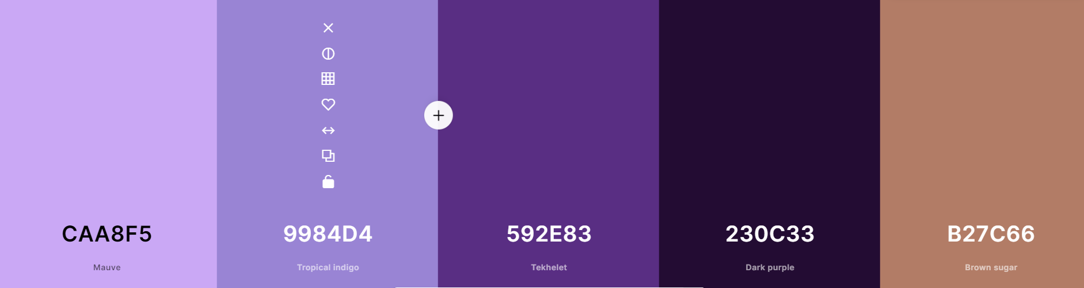
Colour palette generator
Notes:
We all thought on how we were collectively going to agree on a set colour scheme but this was quickly solved with a colour scheme generator which allowed us to mix and match different colours together and efficiently agree on a set colour theme which we carried across the whole site.

